Slide 1

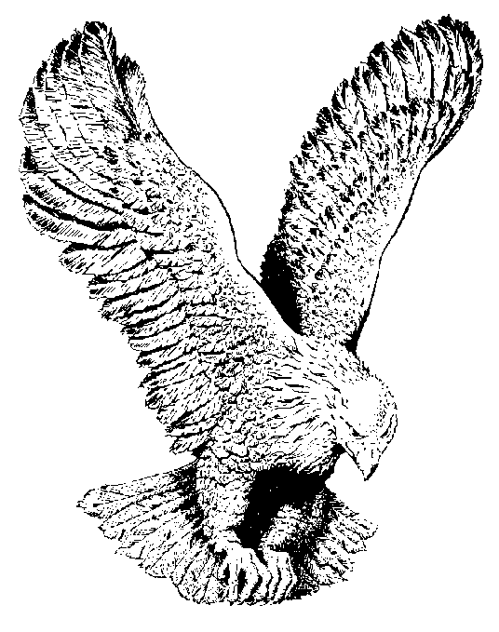
SILENT NIGHT, HOLY NIGHT
Si-lent night, ho-ly night,
All is calm, all is bright
Round yon Vir-gin Moth-er and Child,
Ho-ly in-fant so ten-der and mild,
Sleep in heav-en-ly peace,
Sleep in heav-en-ly peace.

Slide 2
Si-lent night, ho-ly night,
Dark-ness flies, all is light;
Shep-herds hear the an-gels sing,
"Al-le-lu-ia! hail the King!
Christ the Sav-iour is born,
Christ the Sav-iour is born."

Slide 3
Si-lent night, ho-ly night,
Guid-ing Star, lead thy light;
See the east-ern wise men bring
Gifts and hom-age to our King!
Christ the Sav-iour is born
Christ the Sav-iour is born

Slide 4
Si-lent night, ho-ly night,
Wondrous Star, lend thy light;
With the an-gels let us sing
Al-le-lu-ia to our King!
Christ the Sav-iour is born,
Christ the Sav-iour is born.

